Slide 1
DATA STRUCTURES
UNIT - 1

Slide 2
DATA
Data is the basic fact or entity that is utilized in calculation or manipulation.
There are two different types of data Numeric data and Alphanumeric data.
Data can come in the form of text, observations, figures, images, numbers, graphs, or symbols.
For example, data might include individual prices, weights, addresses, ages, names, temperatures, dates, or distances.
Data is a raw form of knowledge and, on its own, doesn't carry any significance or purpose.
When programmer collects such type of data for processing he would require to store them in computer’s main memory.
The process of storing data into computer’s main memory is called representation.
Data to be processed must be organized into particular fashion and these organization leads to structuring of data.

Slide 3
Introduction to Data Structure
Computer is an electronic machine which is used for data processing and manipulation.
When programmer collects such type of data for processing, he would require to store all of them in computer’s main memory.
In order to make computer work we need to know:
Representation of data in computer.
Accessing of data.
How to solve problem step by step.
For doing this task we use data structure.
Using appropriate data structures can help programmers save a good amount of time while performing operations such as storage, retrieval, or processing of data. Manipulation of large amounts of data is easier.

Slide 4
Introduction to Data Structure
Data structure is a representation of the logical relationship existing between individual elements of data.
Data Structure is a way of organizing all data items that considers not only the elements stored but also their relationship to each other.
We can also define data structure as a mathematical or logical model of a particular organization of data items.
The representation of particular data structure in the main memory of a computer is called as storage structure.
The storage structure representation in auxiliary memory is called as file
structure.
It is defined as the way of storing and manipulating data in organized form so that it can be used efficiently.
Note: Auxiliary memory holds programs and data for future use, and, because it is nonvolatile (like ROM), it is used to store inactive programs and to archive data. Early forms of auxiliary storage included punched paper tape, punched cards, and magnetic drums.

Slide 5
Data Structure
Data Structure mainly specifies the following four things
Organization of Data
Accessing methods
Degree of associativity
Processing alternatives for information
Algorithm + Data Structure = Program
Data structure study covers the following points
Amount of memory require to store.
Amount of time require to process.
Representation of data in memory.
Operations performed on the data.

Slide 6
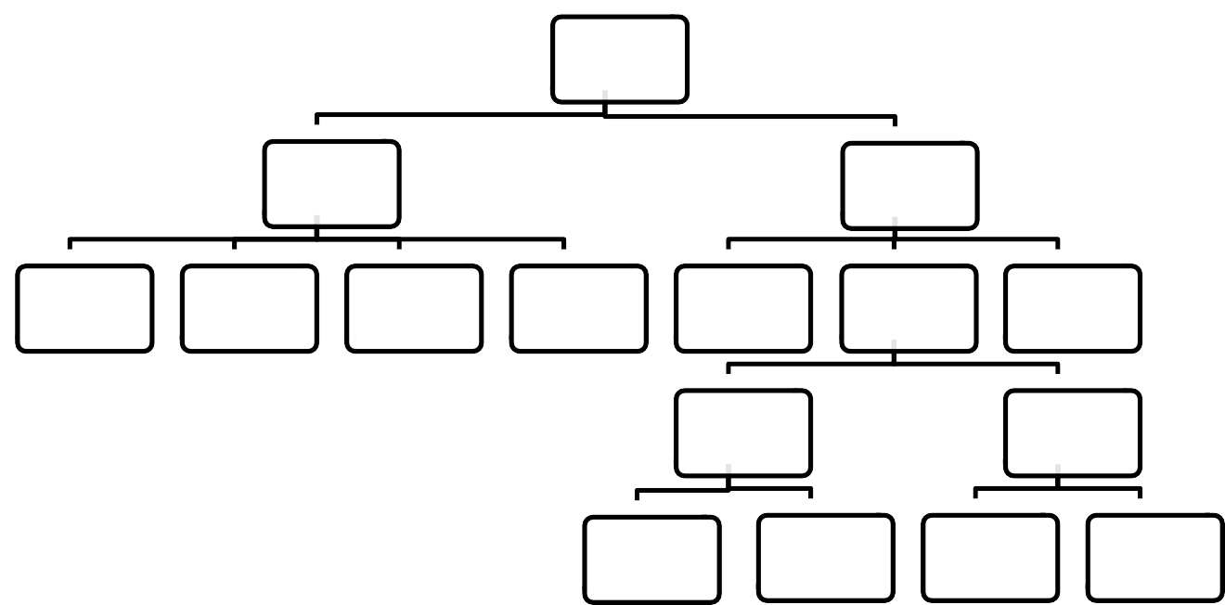
Classification of Data Structure
DATA
STRUCTURE
PRIMITIVE
NON
PRIMITIVE
INTEGER
FLOATING
POINT
CHARACTER
POINTER
ARRAY
LIST
FILE
LINEAR LIST
NON
LINEAR LIST
STACK
QUEUE
GRAPH
TREE

Slide 7
Data structures
Data Structures are normally classified into two broad categories
1) Primitive Data Structure
2) Non-primitive data Structure
Data Types:
A particular kind of data item, as defined by the values it can take, the programming language used, or the operations that can be performed on it.

Slide 8
Primitive Data Structure
Primitive data structures are basic structures and are directly operated upon by machine instructions.
They have different representations on different computers.
Integers, floats, character and pointers are examples of primitive data structures.
These data types are available in most programming languages as built in type.
Integer: It is a data type which allows all values without fraction part. We can use it for whole numbers.
Float: It is a data type which use for storing fractional numbers.
Character: It is a data type which is used for character values.
Pointer: A variable that holds memory address of another variable are called pointer.

Slide 9
Non primitive Data Type
These are more sophisticated data structures.
These are derived from primitive data structures.
The non-primitive data structures emphasize on structuring of a group of homogeneous (similar) or heterogeneous (dissimilar) data items.
Examples of Non-primitive data type are Array, List, and File etc.
A Non-primitive data type is further divided into Linear and Non-Linear data structure
Array: An array is a fixed-size sequenced collection of elements of the same data type.
List: An ordered set containing variable number of elements is called as Lists.
File: A file is a collection of logically related information. It can be viewed as a large list of records consisting of various fields.

Slide 10
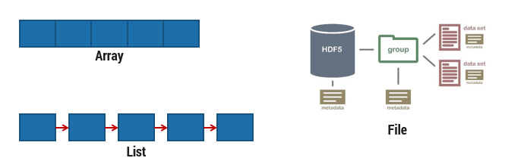
Non primitive Data Type

Slide 11
Linear data structures
A data structure is said to be Linear, if its elements are connected in linear fashion by means of logically or in sequence memory locations.
There are two ways to represent a linear data structure in memory,
Static memory allocation –
Static data structure has a fixed memory size. It is easier to access the elements in a static data structure. An example of this data structure is an array.
Dynamic memory allocation –
In dynamic data structure, the size is not fixed. It can be randomly updated during the runtime which may be considered efficient concerning the memory (space) complexity of the code. Examples of this data structure are queue, stack, etc.
The possible operations on the linear data structure are: Traversal, Insertion, Deletion, Searching, Sorting and Merging.
Examples of Linear Data Structure are Stack and Queue.

Slide 12
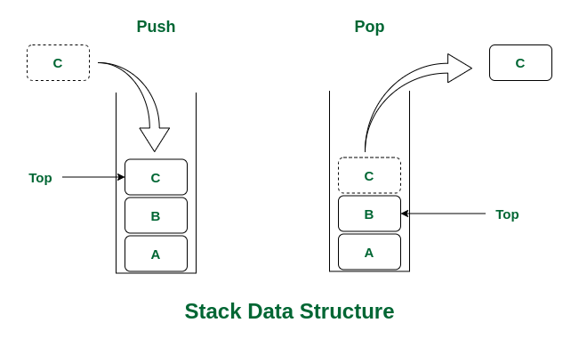
Stack
Stack is a data structure in which insertion and deletion operations are performed at one end only.
The insertion operation is referred to as ‘PUSH’ and deletion operation is referred to as ‘POP’ operation.
Stack is also called as Last in First out (LIFO) data structure.
There are many real-life examples of a stack. Consider an example of plates stacked over one another in the canteen. The plate which is at the top is the first one to be removed, i.e. the plate which has been placed at the bottommost position remains in the stack for the longest period of time. So, it can be simply seen to follow LIFO(Last In First Out)/FILO(First In Last Out) order.
Application of stack in data structure: Evaluation of Arithmetic Expressions, Reverse a Data, Processing Function Calls

Slide 13
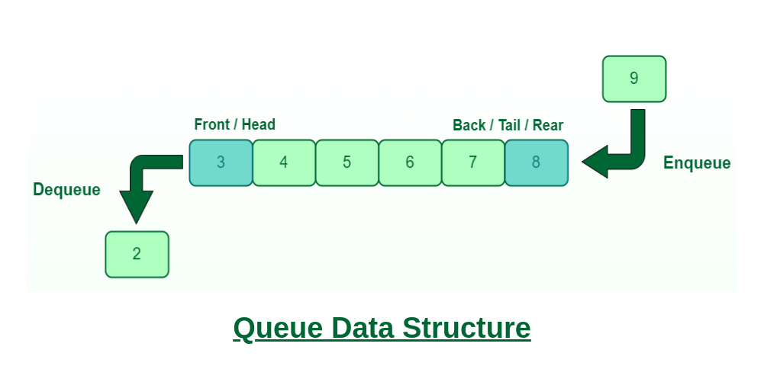
Queue
The data structure which permits the insertion at one end and Deletion at another end, known as Queue.
End at which deletion occurs is known as FRONT end and another end at which insertion occurs is known as REAR end.
Queue is also called as First in First out (FIFO) data structure.
A Queue is like a line waiting to purchase tickets, where the first person in line is the first person served. (i.e. First come first serve).

Slide 14
Queue
Some of the Application of Queue in Data Structure
Here are some of the common application of queue in data structure:
Queues can be used to schedule jobs and ensure that they are executed in the correct order.
Queues can be used to manage the order in which print jobs are sent to the printer.
Queues are used to implement the breadth-first search algorithm.
Queues can be used to manage incoming calls and ensure that they are handled in the correct order.
Queues can be used to manage the order in which processes are executed on the CPU.
Queues can be used for buffering data while it is being transferred between two systems. When data is received, it is added to the back of the queue, and when data is sent, it is removed from the front of the queue.
Applied as buffers on playing music in the mp3 players or CD players.
Applied on handling the interruption in the operating system.
Applied to add a song at the end of the playlist.
Applied as the waiting queue for using the single shared resources like CPU, Printers, or Disk.

Slide 15
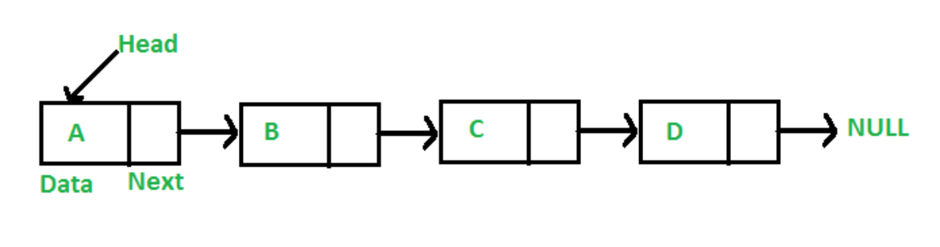
Linked List
A linked list is a linear data structure, in which the elements are not stored at contiguous memory locations. In simple words, a linked list consists of nodes where each node contains a data field and a reference(link) to the next node in the list.

Slide 16
Linked List
Types :
Singly Linked List
Circular Linked List
Doubly Linked List
Applications of Linked List in Computer Science
Representing polynomials, Polynomial manipulation, Implementing stacks and queues, Implementing graphs
Music players (play list), Image viewers, Web browsers

Slide 17
Nonlinear data structures
Nonlinear data structures are those data structure in which data items are not arranged in a sequence.
Examples of Non-linear Data Structure are Tree and Graph.

Slide 18
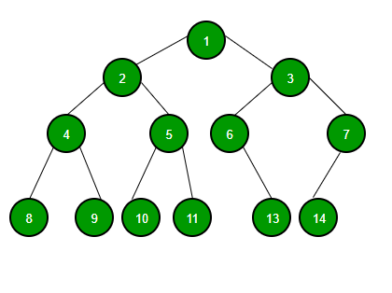
Tree
A tree can be defined as finite set of data items (nodes) in which data items are arranged in branches and sub branches according to requirement.
Trees represent the hierarchical relationship between various elements.
Tree consist of nodes connected by edge, the node represented by circle and edge lives connecting to circle.
Another example of a tree structure that you probably use every day is a file system. In a file system, directories, or folders, are structured as a tree.

Slide 19
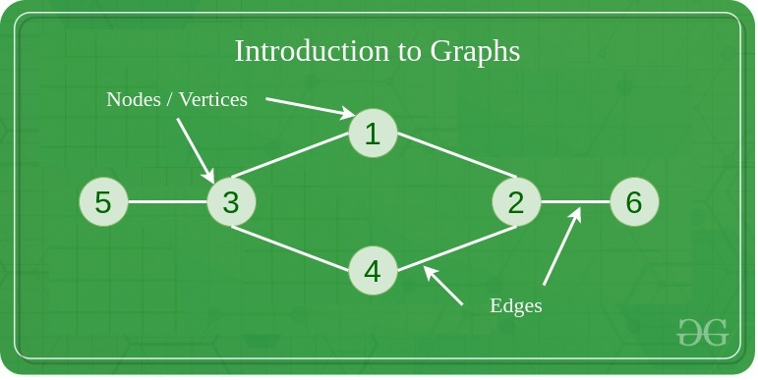
Graph
A Graph is a non-linear data structure consisting of vertices and edges.
The vertices are sometimes also referred to as nodes and the edges are lines or arcs that connect any two nodes in the graph.
More formally a Graph is composed of a set of vertices( V ) and a set of edges( E ). The graph is denoted by G(E, V).

Slide 20
Graph
Graphs are used to solve many real-life problems.
Graphs are used to represent networks.
The networks may include paths in a city or telephone network or circuit network. Graphs are also used in social networks like linkedIn, Facebook.
For example, in Facebook, each person is represented with a vertex(or node). Each node is a structure and contains information like person id, name, gender, locale etc.
A tree can be viewed as restricted graph.
Graphs have many types:
Un-directed Graph
Directed Graph
Mixed Graph
Multi Graph
Simple Graph
Null Graph
Weighted Graph

Slide 21
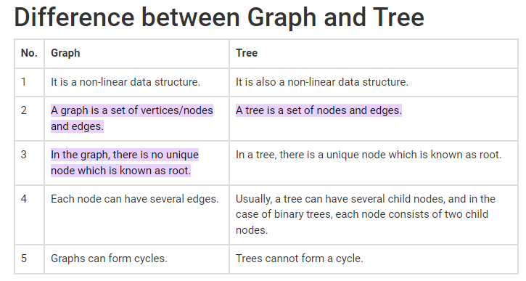

Slide 22
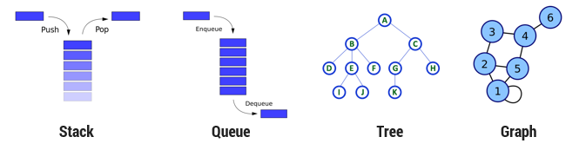
Linear – Non Linear Data types

Slide 23
Difference between Linear and Non Linear Data Structure
Linear Data Structure | Non-Linear Data Structure
Every item is related to its previous and next items. | Every item is attached with many other items.
Data is arranged in linear sequence. | Data is not arranged in sequence.
Data items can be traversed in a single run. | Data cannot be traversed in a single run.
Eg. Array, Stacks, linked list, queue. | Eg. tree, graph.
Implementation is easy. | Implementation is difficult.

Slide 24
Operation on Data Structures
Design of efficient data structure must take operations to be performed on the data structures into account. The most commonly used operations on data structure are broadly categorized into following types
1) Create
The create operation results in reserving memory for program elements. This can be done by declaration statement. Creation of data structure may take place either during compile-time or run-time. malloc() function of C language is used for creation.
2) Destroy
Destroy operation destroys memory space allocated for specified data structure. free() function of C language is used to destroy data structure.

Slide 25
Operation on Data Structures
3) Selection
Selection operation deals with accessing a particular data within a data structure.
4) Updation
It updates or modifies the data in the data structure.
5) Searching
It finds the presence of desired data item in the list of data items, it may also find the locations of all elements that satisfy certain conditions.

Slide 26
Operation on Data Structures
6) Sorting
Sorting is a process of arranging all data items in a data structure in a particular order, say for example, either in ascending order or in descending order.
7) Merging
Merging is a process of combining the data items of two different sorted list into a single sorted list.
8) Splitting
Splitting is a process of partitioning single list to multiple list.
9) Traversal
Traversal is a process of visiting each and every node of a list in systematic manner.

Slide 27
Time and space analysis of algorithms
Algorithm:
An essential aspect to data structures is algorithms.
Data structures are implemented using algorithms.
An algorithm is a procedure that you can write as a C function or program, or any other language.
An algorithm states explicitly how the data will be manipulated.

Slide 28
Algorithm Efficiency
Some algorithms are more efficient than others.
We would prefer to choose an efficient algorithm.
The complexity of an algorithm is a function describing the efficiency of the algorithm in terms of the amount of data the algorithm must process.
Usually there are natural units for the domain and range of this function.
There are two main complexity measures of the efficiency of an algorithm
1) Time complexity - a measure of amount of time for an algorithm to execute.
2) Space Complexity - a measure of the amount of memory needed for an algorithm to execute.

Slide 29
Space complexity
Whenever we say that our algorithm is sufficient then it means that the algorithm is solving the problem in less amount of time while taking the least amount of space.
Let's take an example of sorting algorithms like insertion and heap sort doesn't creates a new array during sorting as they are in-place sorting techniques but merge sort creates an array during sorting of elements which takes an extra space so if there is a concern of space then obviously one will prefer the insertion or heap sort.
Suppose you are provided with a task to sort the given array, so there are many sorting algorithms but you will choose the optimized and efficient one always and for choosing that you have to analyze different algorithms on the basis of their space and time complexity.
So as we know that analyzing the algorithm is a much-needed task after designing an algorithm so as to increase the efficiency of an algorithm.
During analyzing any problem or algorithm you all may have encountered time complexity and space complexity.

Slide 30
Space complexity
Space complexity is nothing but the amount of memory space that an algorithm or a problem takes during the execution of that particular problem/algo.
The space complexity is not only calculated by the space used by the variables in the problem/algo it also includes and considers the space for input values with it.
There is a sort of confusion among people between the space complexity and the auxiliary space.
So let’s be clear about that, so auxiliary space is nothing but the space required by an algorithm/problem during the execution of that algorithm/problem and it is not equal to the space complexity because space complexity includes space for input values along with it also.
So we can say that space complexity is the combination or sum up of the auxiliary space and the space used by input values.
Space Complexity = Auxiliary Space + Space used for input values
Space complexity depends on variables, data structures, allocations, function call

Slide 31
Time complexity
Time Complexity is a function describing the amount of time an algorithm takes in terms of the amount of input to the algorithm.
"Time" can mean the number of memory accesses performed, the number of comparisons between integers, the number of times some inner loop is executed, or some other natural unit related to the amount of real time the algorithm will take.
So time complexity depends on operations, comparisons, loops, pointer reference, function call to outside.

Slide 32
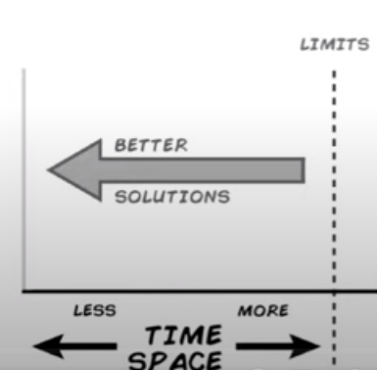
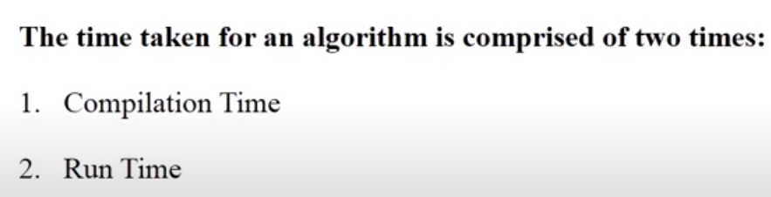
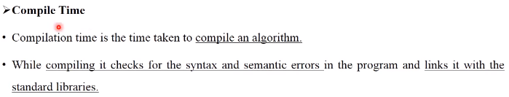
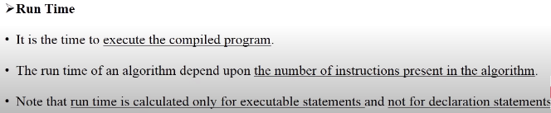
Time complexity

Slide 33
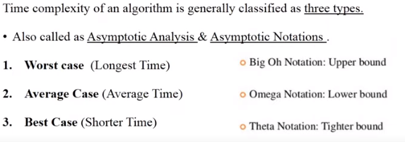
Time complexity
Worst case(longest time) Big O (upper bound)
Average case (average time) Theta (tighter bound)
Best Case(shorter time) Omega (lower bound)

Slide 34
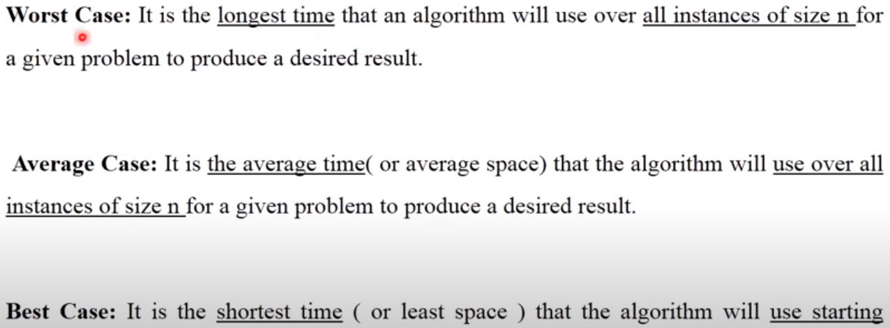
Time complexity

Slide 35
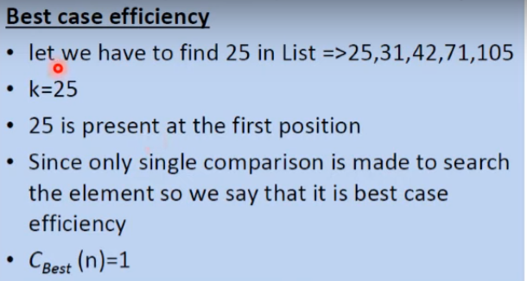
Time complexity

Slide 36
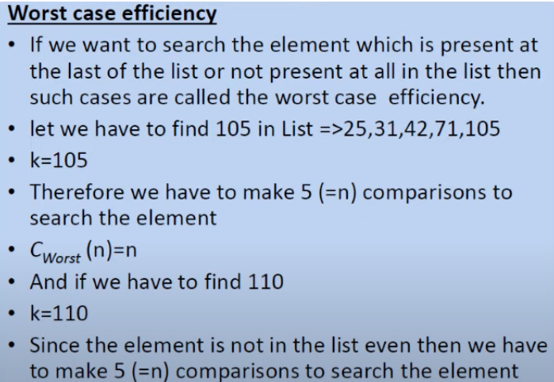

Time complexity

Slide 37
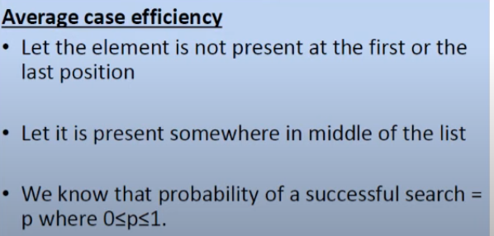
Time complexity
Probability of an unsuccessful search =1-p

Slide 38
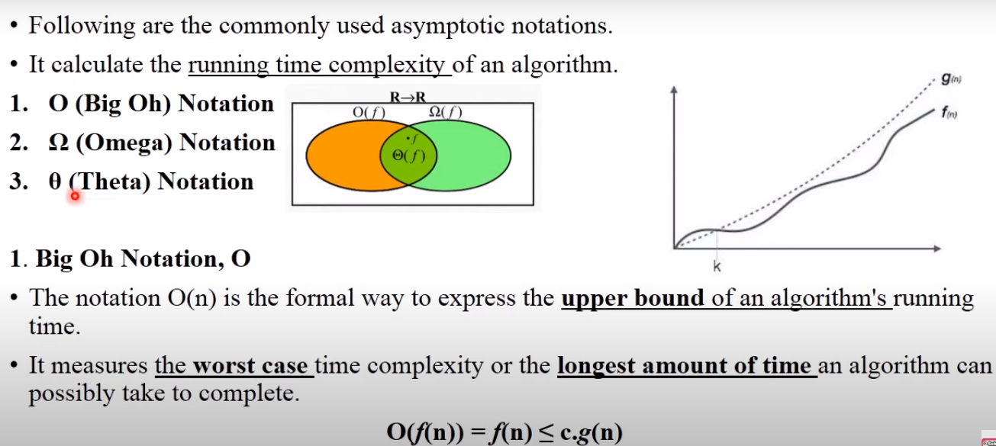
Time complexity

Slide 39
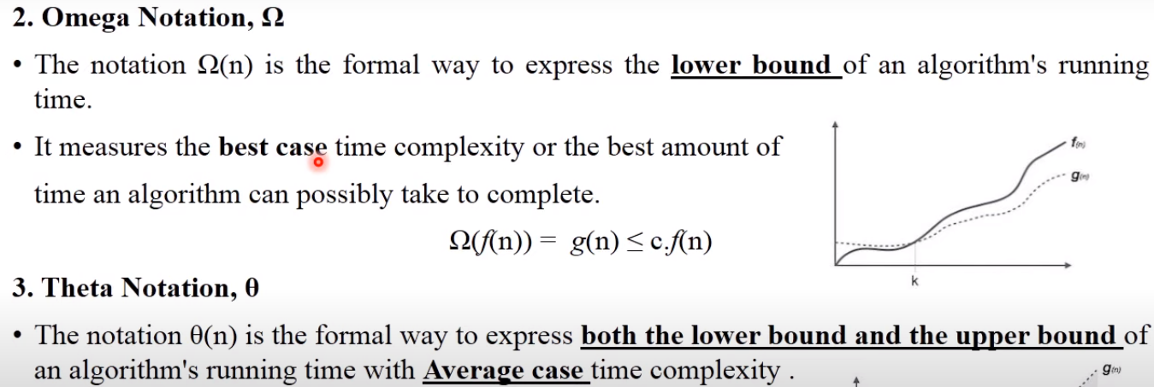
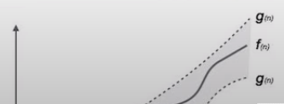
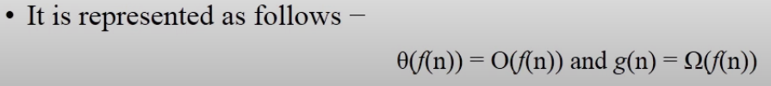
Time complexity

Slide 40
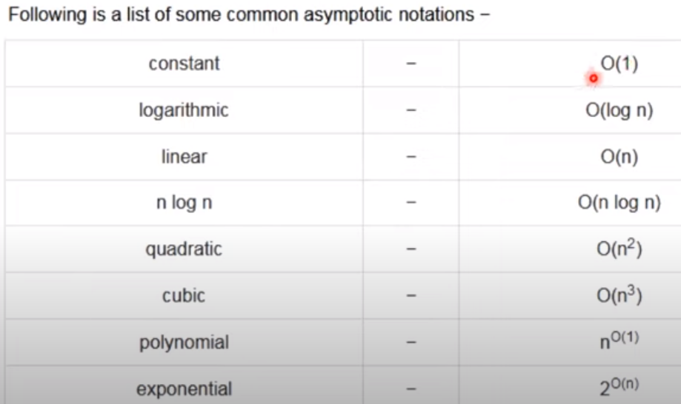
Time complexity

Slide 41
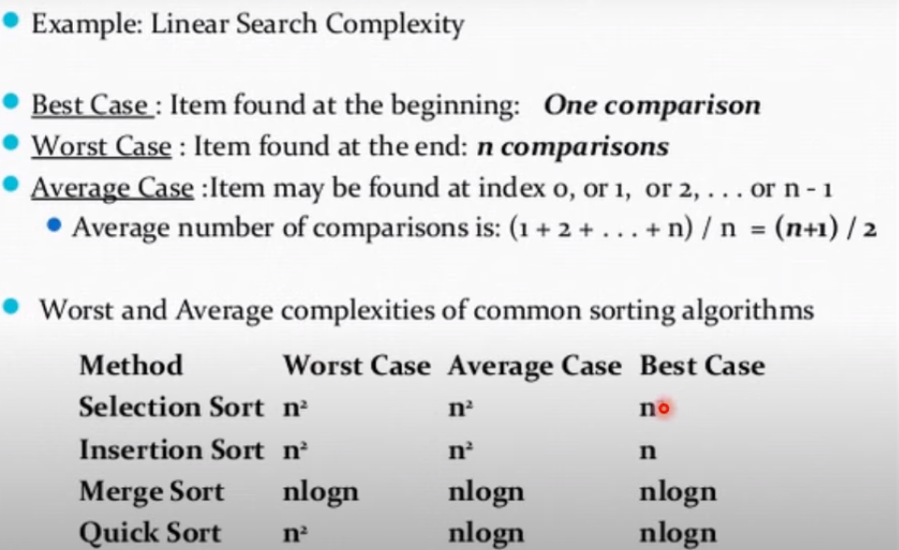
Time complexity

Slide 42
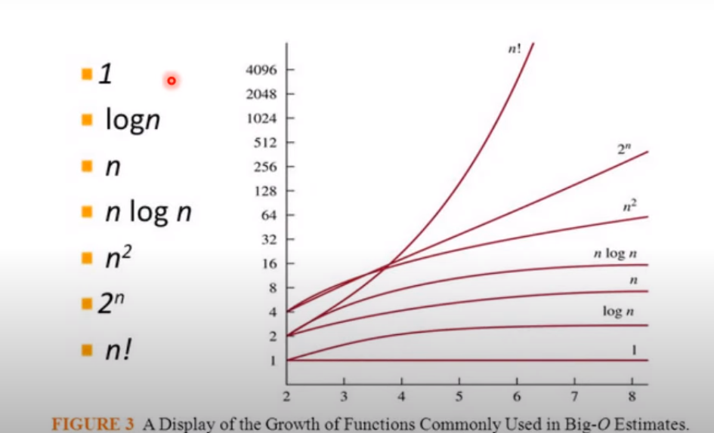
Time complexity

Slide 43
Time complexity
Q. Imagine a classroom of 100 students in which you gave your pen to one person. You have to find that pen without knowing to whom you gave it.
Here are some ways to find the pen and what the O order is.
O(n²): You go and ask the first person in the class if he has the pen. Also, you ask this person about the other 99 people in the classroom if they have that pen and so on, This is what we call O(n²). // nested loop
O(n): Going and asking each student individually is O(N). // single loop
O(log n): Now I divide the class into two groups, then ask: “Is it on the left side, or the right side of the classroom?” Then I take that group and divide it into two and ask again, and so on. Repeat the process till you are left with one student who has your pen. This is what you mean by O(log n).

Slide 44
Time complexity
I might need to do:
The O(n²) searches if only one student knows on which student the pen is hidden.
The O(n) if one student had the pen and only they knew it.
The O(log n) search if all the students knew, but would only tell me if I guessed the right side.
Note:Time Complexity considers how many times each statement executes.

Slide 45
Big O Notation
Big O Notation is a tool used to describe the time complexity of algorithms.
It calculates the time taken to run an algorithm as the input grows.

Slide 46
Time complexity
1)Example:
print("Hello World") - > O(1)
2) Example:
int i, n = 8;
for (i = 1; i <= n; i++) {
printf("Hello World !!!\n");
}
Complexity: O(n)

Slide 47
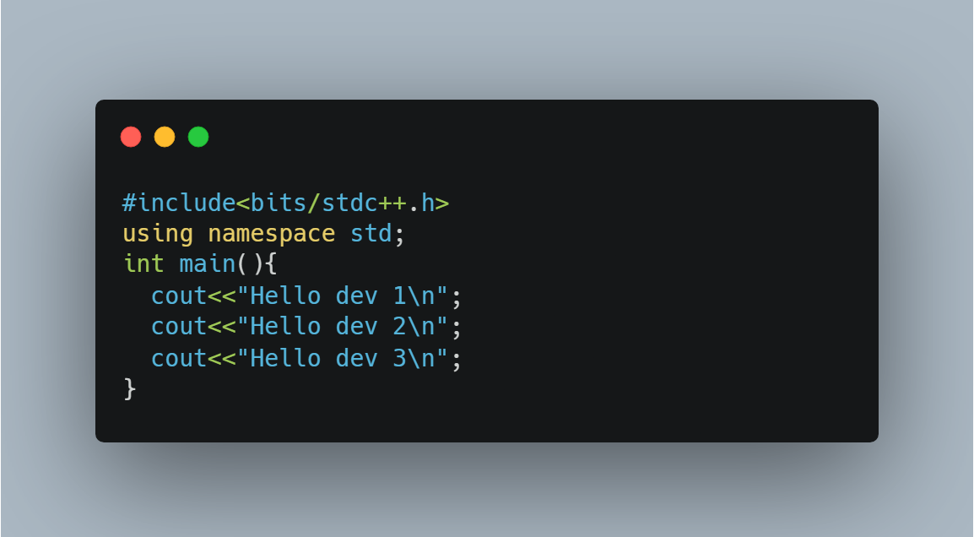
Time complexity
There are three separate statements inside the main() function, the overall time complexity is O(1) because each statement only takes unit time to complete execution.

Slide 48
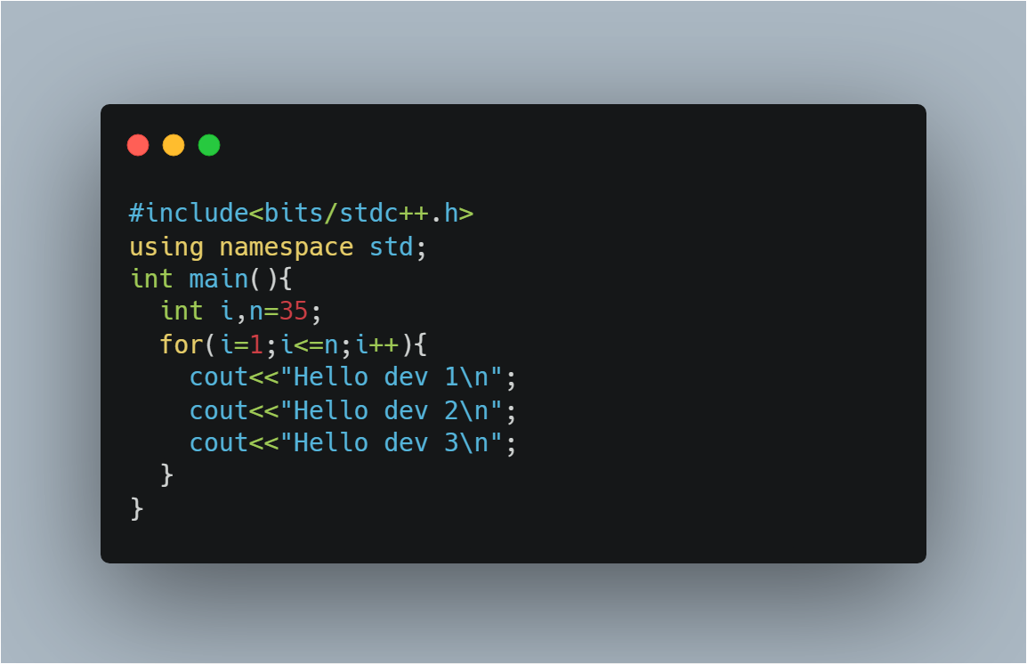

Time complexity

Slide 49
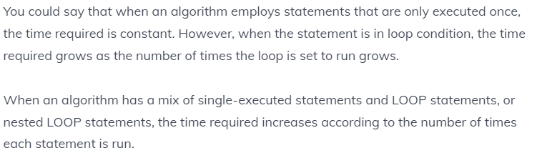
Time complexity

Slide 50
Time complexity
Sum(a, b) { return a + b }
Time Complexity = O(1)

Slide 51
Time complexity
total =0 // no of times=1
for i=0 to n-1 // no of times=n+1 (+1 for the end false condition)
sum = sum + A[i] // no of times=n
return sum // no of times = 1
Time complexity = O(n)

Slide 52
Day 1 Programs
Sum of digits algorithm
To get sum of each digits by c program, use the following algorithm:
Step 1: Get number by user
Step 2: Get the modulus/remainder of the number
Step 3: sum the remainder of the number
Step 4: Divide the number by 10
Step 5: Repeat the step 2 while number is greater than 0.

Slide 53
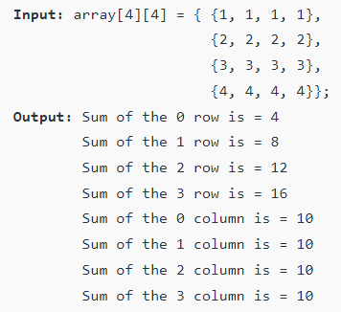
Day 1 Programs
Write a program to find the total of each rows and columns in a given matrix.

Slide 54
Day 1 Programs
Algorithm to find the total of each rows and columns in a given matrix.
Algorithm
STEP 1: START
STEP 2: DEFINE rows (m) , cols (n), sum
STEP 3: input the order of matrix // enter m and n
STEP 4: input the coefficient of the matrix // for loop nested : outer loop i=0;i<m (rows) & inner loop j=0;j<n (cols)
STEP 5: calculate sum of the row // nested for loop :outer loop i=0;i<m (rows) & inner loop j=0;j<n (cols) {sum=sum+a[i][j]}
STEP 5: Print sum
STEP 6: Set sum =0
STEP 7: calculate sum of the col// nested for loop :outer loop i=0;i<n (cols) & inner loop j=0;j<n (rows) {sum=sum+a[i][j]}
STEP 8: Print sum
STEP 9: Set sum =0
STEP 10: END

Slide 55
Day 1 Programs
Find second highest element from array. (23,12,43,40)
Input size and elements in array, store it in some variable say size and arr.
Declare two variables max1 and max2 to store first and second largest elements. Store minimum integer value in both i.e. max1 = max2 = INT_MIN.
Note: INT_MIN specifies that an integer variable cannot store any value below this limit. Values of INT_MAX and INT_MIN may vary from compiler to compiler. Following are typical values in a compiler where integers are stored using 32 bits. Value of INT_MAX is +2147483647. Value of INT_MIN is -2147483648.
3. Iterate though all array elements, run a loop from 0 to size - 1. Loop structure should look like for(i=0; i<size; i++).
4. Inside loop, check if current array element is greater than max1, then make largest element as second largest and current array element as largest. Say, max2 = max1 and max1 = arr[i].
5. Else if the current array element is greater than max2 but less than max1 then make current array element as second largest i.e. max2 = arr[i].

